Slide 1
University of St Andrews Library: Journal hosting service using OJS
Jackie Proven
Notes:
For clarity – OJS (Open Journal Systems) is developed by the Public Knowledge Project (PKP):
“OJS is open source software made freely available to journals worldwide for the purpose of making open access publishing a viable option”
In this case study I aim to give you an insight into our experience, gained over 4 years, covering these questions:
Why and how did we get started?
What have we learnt?
What are the benefits, challenges, and the rewards, of being involved in publishing?
How does Open Journal Systems (OJS) help?
How would a hosting service work for you?
Where do we go next?

Slide 2



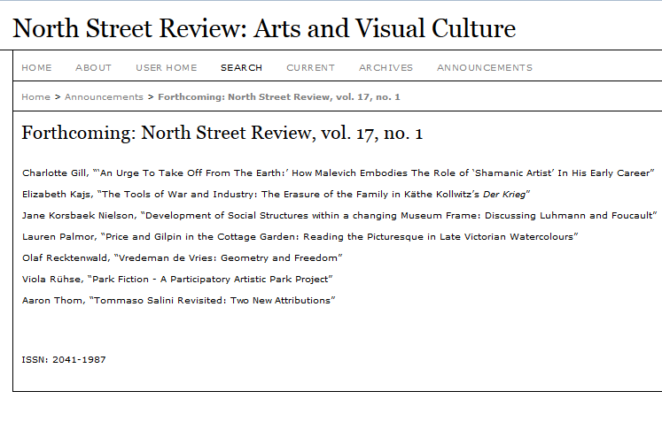
Journal hosting service – the pilot
One journal’s 20-year journey
Hugely valuable learning experience – ‘soft’ issues more important than ‘technical’ issues
Notes:
We began with a pilot project… an OA journal that has been 20 years in development!
Inferno was a print journal run by Postgraduate Art History students, with copies held in the Library since 1994. A few articles were deposited in our fledgling eprints repository in 2004, then migrated to Dspace in 2008. In 2009 the journal became St Andrews Journal of Art History and Museum Studies and was listed on School web pages. In 2010 the journal was looking for a new online presence… and we were investigating OJS as a potential solution to support publishing in response to several requests to the Library.
In discussions with the Editor at that time we decided to try and create a complete digital archive, and make as much as we could open access via OJS
We learned the ropes with this journal – particularly copyright issues
In 2013 the journal became North Street Review and, has “evolved into a publication with true international scope and interest.”
http://ojs.st-andrews.ac.uk/index.php/nsr

Slide 3
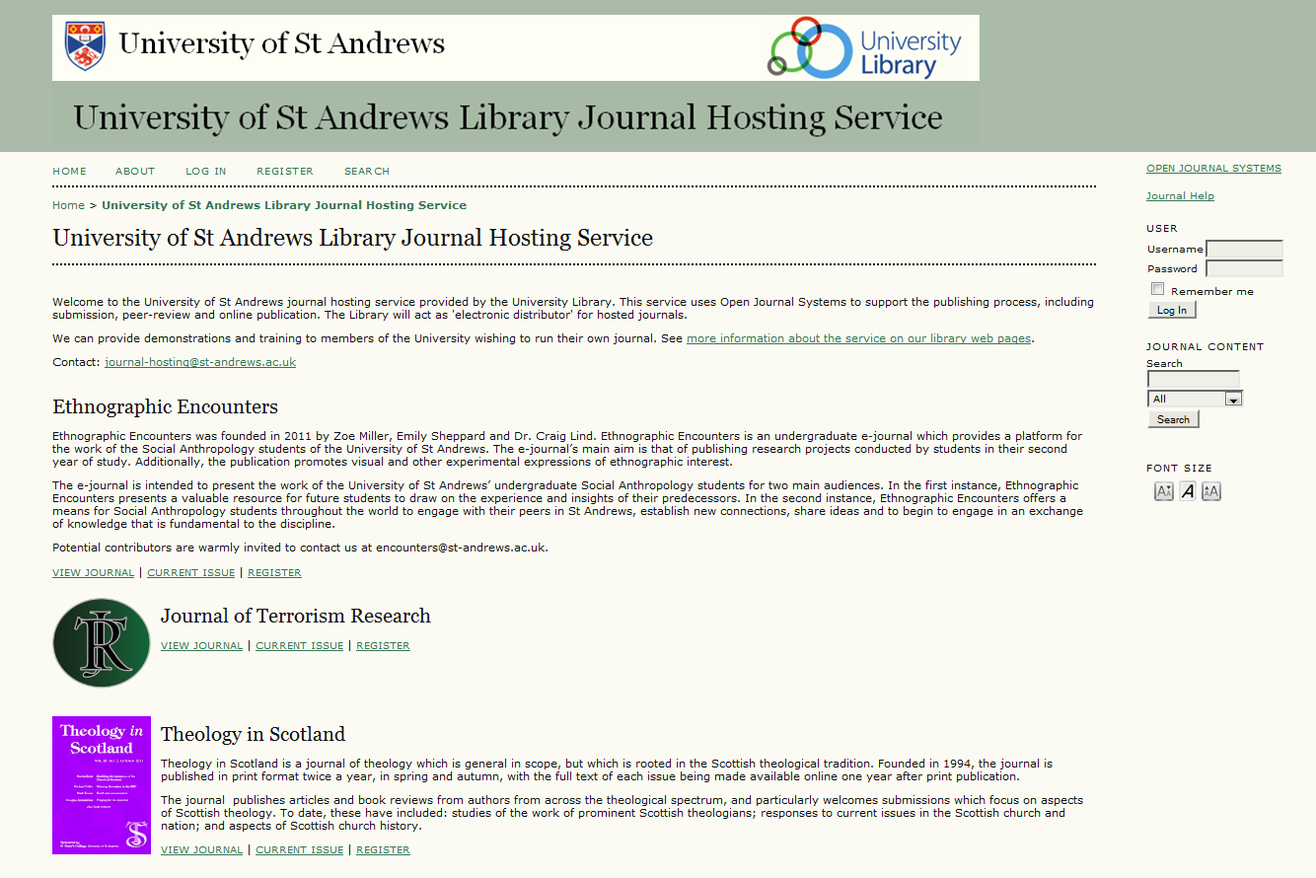
Journal hosting service – out of the box
2012: Established service with 3 journals
http://ojs.st-andrews.ac.uk/
Notes:
In 2012 we launched our service with 3 very different journals –
Ethnographic Encounters – the ‘learning’ journal, inspired by staff who contacted us in 2011, but is run by UG Social Anthropology students. There is a new team every year, with limited resources. The journal has in turn influenced how a 2nd year UG module is taught.
JTR - Existing online staff journal with fully online processes, experienced Editorial staff, and their own technical support. They came to us via Academic liaison, with some existing knowledge of OJS and of other Manuscript systems (eg Scholar One). Found OJS easier!
TiS is an established print journal – delayed OA, Editorial Board with external affiliations, still focussed on print. Gradually moving content online since 2010. A lot of work contacting authors for permissions

Slide 4
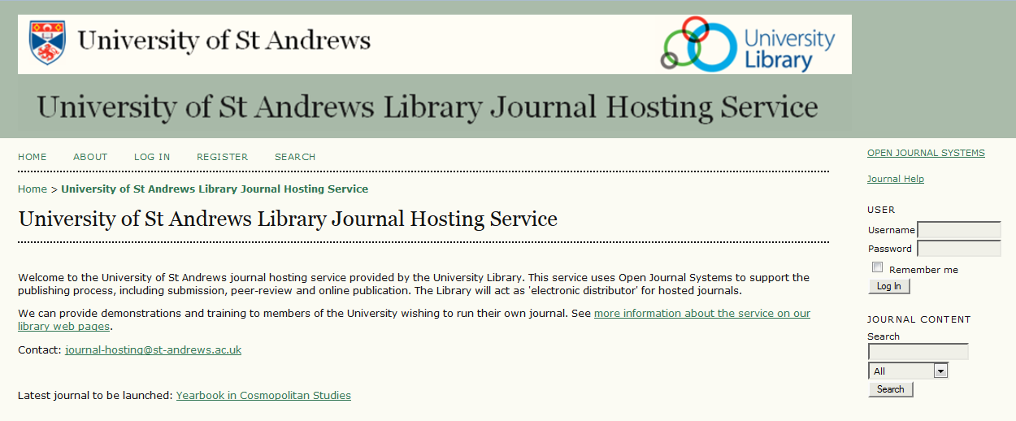
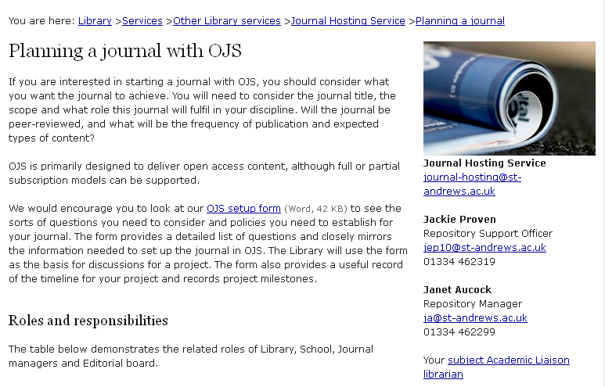











Journal hosting service – where we are now
Notes:
2014: Now part of our core OA services with 10 journals and supporting web pages
Main site still essentially ‘out of the box’
Technical support starting to creak, but we still get good feedback on our ‘shoestring’ service
We have done very little promotion – all the journals have come through word-of-mouth or (since we launched the service) finding our web pages

Slide 5
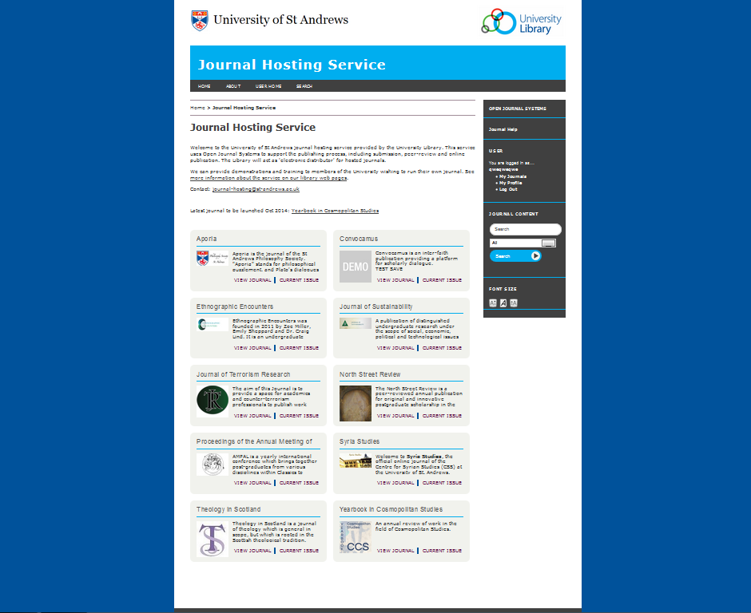
Journal hosting service – coming soon
Notes:
We have been reviewing our OJS platform and matching the service against increasing user expectations
Upgrades are relatively straightforward, but someone needs to do testing of new versions, and sometimes bug-fixing. There can be unexpected server-side work. We are looking at options for additional technical support including input from a web designer. However it has been surprisingly difficult, particularly matching web skills with an understanding of OJS

Slide 6
Journal hosting service – our model
Library (with IT services) | Library / School | School + Editorial board
Journal hosting | Journal management | Editor(s)
Technical support | Set up functionality | Define policies
OJS user training | Configure templates | Manage review process
Advice on copyright | Customise look and feel | Track submissions
Support for access and preservation | Register users and assign roles | Create and publish issues
Open Access advocacy | Administration | Create author guidelines
Notes:
This is how we portray our hosting service
The Library effectively provides the platform, acts as ‘electronic distributor’ and provides a bundle of additional services
Journal management is ‘owned’ by school/depts – Library can assist at set-up stage and provide extra help when required
Editorial functions are devolved to journal owners (Library can provide user training and advice)
So as you can see there are areas of overlap already and managing user expectations becomes a challenge.

Slide 7
Journal hosting service – the reality
Technical support
Free, open source software, easy to install, stable
What about upgrades and development?
User support
Thorough knowledge of OJS easily gained through good documentation and strong user community
TIME required! Support needs vary greatly. Is it a core service?
Publishing and management
The Journal is responsible for all content, policies and processes
When do activities ‘overlap’? Who does the reader recognise as ‘the publisher’?
Notes:
So in terms of OJS itself, we have managed to maintain the platform for 4 years, but we now feel a bit stuck on the technical side.
We learned everything through experience, and the excellent resources available from PKP. Due to the organic growth we built up our knowledge over time, but we now have to prioritise amid competing demands as our Open Access support remit has expanded.
The ‘distributor / publisher’ split has worked until now as we are flexible in our approach, while ensuring journal teams are aware of the arrangement.
To throw it open…
Can we continue to avoid clear definitions?
As we add more to our service bundle, are we gradually entering the realms of a publisher? Is this OK, provided we continue to be clear about our responsibilities and manage user expectations? Even if we are clear internally, is the situation clear to readers/users? Does it matter??
What about when we incur costs (eg buying in technical support, registering DOIs, increasing staff hours). So far the Library has been happy to absorb this as we firmly believe this service is just another way we meet our user’s needs.

Slide 8
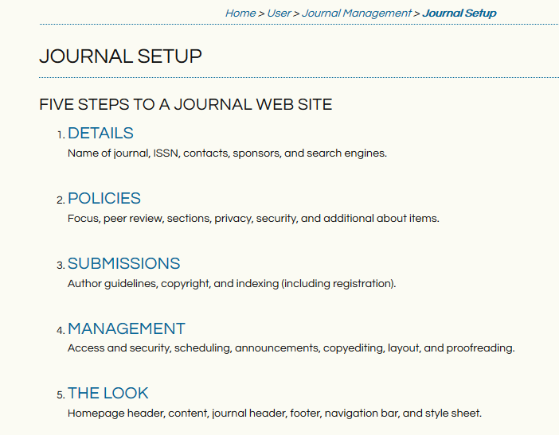
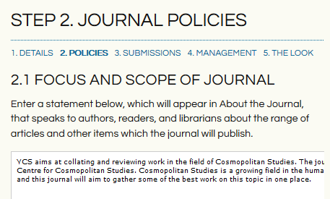
Journal setup process
OJS steps users through the process with tips and recommendations
Notes:
To come back to practicalities, how do we actually go about getting a journal up and running?
Everything required to run a journal is part of the system – but you need to have formulated your plan before arriving in OJS! Also, OJS doesn’t always seem logical so we designed our own form to follow a more realistic dialogue – I have to then map the outcome to appropriate configuration settings.

Slide 9
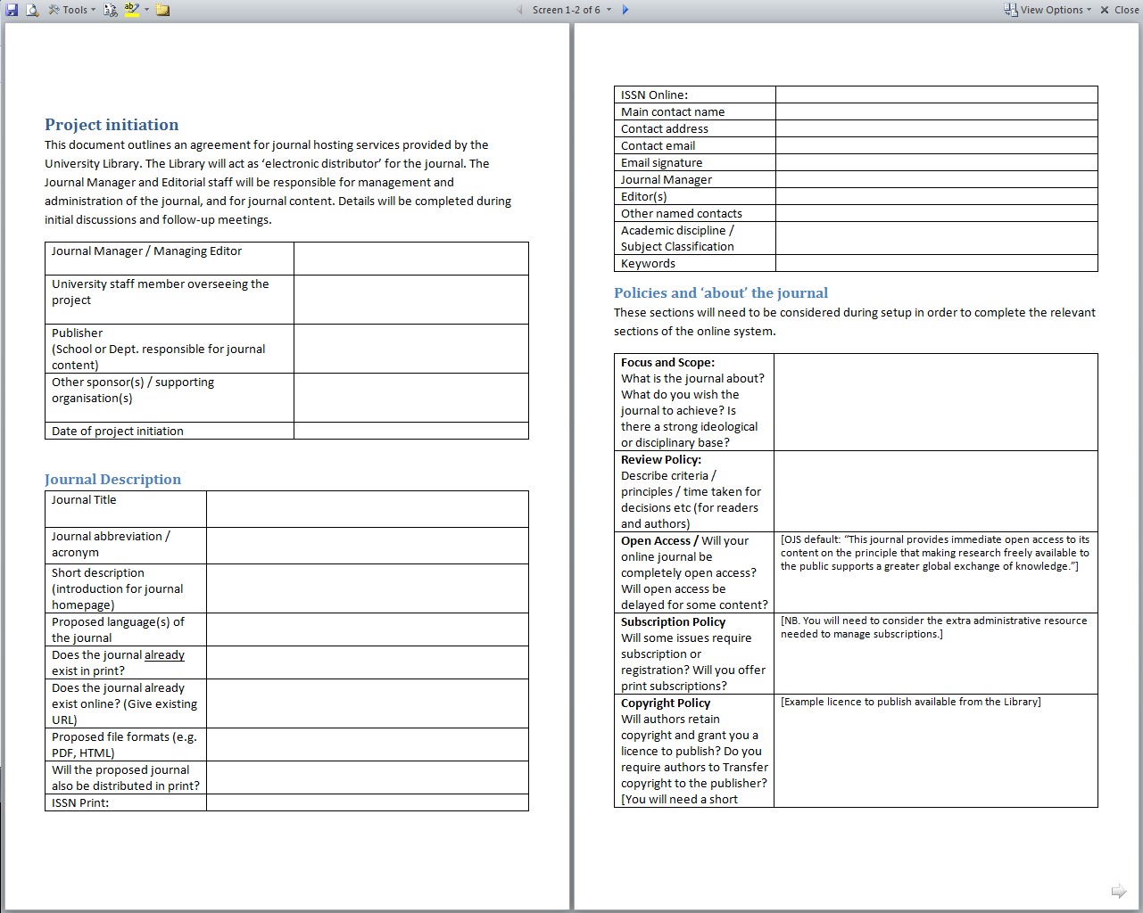
Supporting the setup process
Framework of our hosting setup process encourages additional dialogue
Notes:
Journal setup becomes an iterative process, with Editors (particularly students) often formulating their ideas for their journal based on gradually increasing knowledge.
Our setup form ensures we don’t forget important issues, and allows us to return to ideas for future development.
Initial questions from us include…
What resources do you have in your team?
Is there existing content, can it be made OA?
How often will you publish?
Have you defined journal’s scope, editorial policies, author guidelines?
How will copyright and licences be handled?
Will you have multiple sections, different formats, supplementary material?
(Should we revisit our setup form to more closely match the OJS steps?)

Slide 10
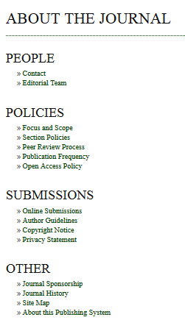
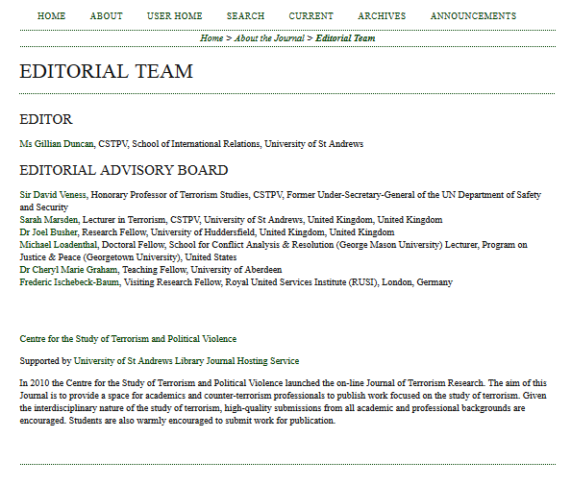
Benefits of OJS
OJS prompts users to think about their policies and how to communicate them effectively
OJS encourages visibility for people – great for building teams
Notes:
Having stepped through the process, OJS can provide great visibility for everyone concerned, as well as the journal, its discipline and its authors

Slide 11
Iterative setup process
Common questions
How can I customise the look of the journal?
How do I upload content?
Are there any costs?
Hosting: 0.25 FTE, hardware and backup, minimal technical support, CrossRef membership – costs absorbed by Library
Journals: printing and publicity, web/logo design – costs generally absorbed by Societies or Schools, or met through one-off grants.
Staff are volunteers or doing as part of existing roles
Readers: All online content is free. Some journals charge for print versions
Authors: Submission/Publishing is free, i.e. no Article Processing Charges (APCs)
Notes:
Hosting costs – no costs for our service as it is part of Library strategy to support OA publishing, and the needs of our users (We currently absorb the relatively small technical/staff costs). Nominally 0.25 FTE
Journal costs will depend on several questions – will the team be volunteers, or doing it as part of their normal work? Will you need to outsource any support that the Library can’t provide, eg web/logo design? Do you want to produce print versions? None of our journals charge APCs, some charge small subscriptions for print version
[Interesting research project being undertaken in our School of History, shows that journal publishing was not profitable until relatively recently.]

Slide 12
Iterative setup process
Other questions
Will OJS help with tracking submissions?
How will readers find our journal?
How do we manage copyright?
How do we express our journal policies?
How do I get an ISSN?

Slide 13
Services beyond OJS
Drafting copyright agreements and statements
Suggesting relevance of Open Access to mission
Thinking creatively about Open Access models
Discussing costs and sources of funding
Sharing experience on processes and workflows
Promoting discovery
Preservation and other repository services
Notes:
These ‘soft’ services are crucial
We can head off any unexpected copyright issues – particularly with student Editors
We can go into OA advocacy mode to discuss benefits of OA and possible ways of achieving visibility
In relation to costs, we might discuss the resource implications for charging publication fees, or suggest how a journal could be supported through alternative means
We can share experience of processes, for example when to handle Submissions offline or through the system, which editorial roles will be needed, how frequently the journal is scheduled for publication.
Clearly, the Library can help promote Discovery
We can offer other related services such as Repository for preservation; advice for metadata, harvesting, indexing, reading tools, implementing DOIs etc…
Other Editors can help, and we can put people in touch

Slide 14
The end results
Monthly article downloads 2014
 | Jan | Feb | Mar | Apr | May | Jun | Jul | Aug | Sep | Oct | Nov | Dec | YTD Total
Journal of Terrorism Research* | 11258 | 11921 | 16255 | 13683 | 15645 | 13050 | 13009 | 11080 | 10697 | 10444 |  |  | 127,042
Theology in Scotland | 1055 | 1076 | 1778 | 1676 | 1248 | 1825 | 2370 | 1860 | 1037 | 966 |  |  | 14,891
Ethnographic Encounters | 583 | 370 | 532 | 687 | 648 | 401 | 611 | 404 | 538 | 379 |  |  | 5,153
North Street Review | 331 | 302 | 385 | 373 | 233 | 323 | 616 | 348 | 175 | 212 |  |  | 3,298
Journal of Sustainability | 168 | 109 | 152 | 117 | 138 | 177 | 185 | 131 | 139 | 93 |  |  | 1,409
Aporia | 45 | 37 | 67 | 95 | 86 | 51 | 116 | 74 | 36 | 41 |  |  | 648
Proceedings of AMPAL 2013 | 113 | 140 | 161 | 124 | 172 | 100 | 190 | 100 | 47 | 46 |  |  | 1,193
Syria Studies | 35 | 280 | 128 | 152 | 93 | 296 | 168 | 126 | 72 | 66 |  |  | 1,416
Yearbook in Cosmopolitan Studies (launched Oct 2014) | - | - | - | - | - | - | - | - | - | 69 |  |  | 69
[*JTR has HTML versions as well as PDFs]
Notes:
These are in-built COUNTER stats, so should be comparable to ‘full text article requests’ reported from other platforms
We haven’t implemented Google Analytics

Slide 15
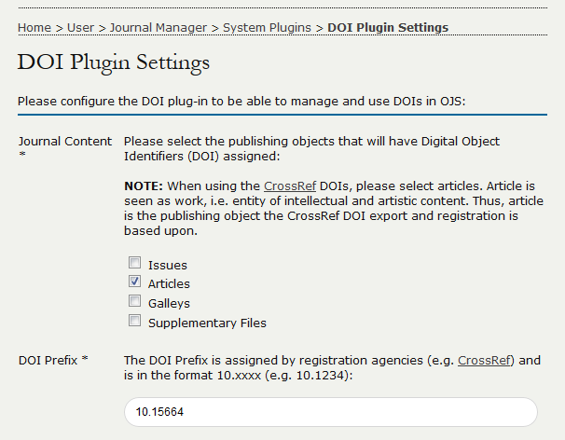
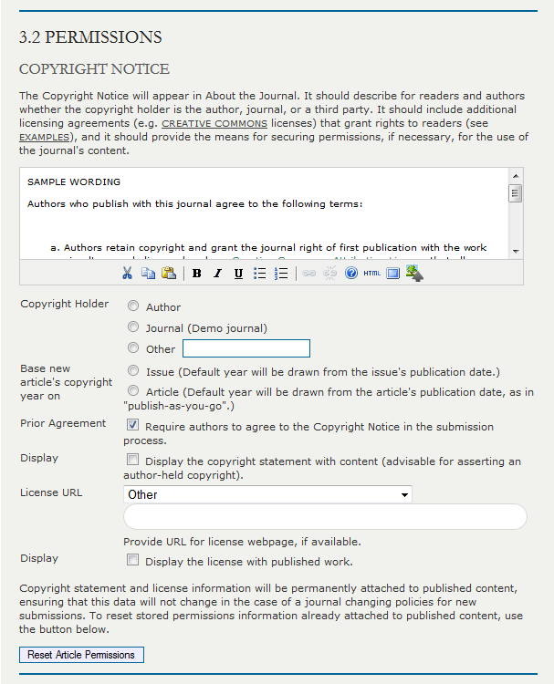
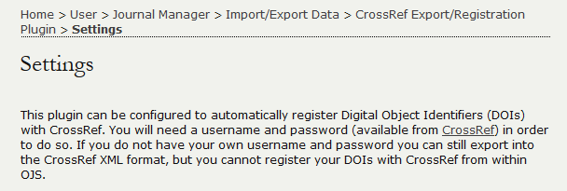
What’s next in OJS?
New features
Clearer setup tips
Notes:
We are about to upgrade to v2.4.5, and implementing DOIs will be the next big step forward. We have had some concerns - again about responsibilities and resources, but decided we will just do it! All journals are on board with how important it is so are likely to take on any responsibility we need to delegate – they can in turn delegate to their authors.
New ‘Set up’ tips are even clearer.

Slide 16
Journal hosting service – growing the model
Library (with IT services) | Library / School | School + Editorial board
Journal hosting | Journal management | Editor(s)
Technical support | Set up functionality | Define policies
OJS user training | Configure templates | Manage review process
Advice on copyright | Customise look and feel | Track submissions
Support for access and preservation | Register users and assign roles | Create and publish issues
Open Access advocacy | Administration | Create author guidelines
Create and register DOIs
Create HTML versions of articles
Deposit preservation copies in our repository
Notes:
To return briefly to our model:
Where will new developments sit in this model? How would we design it if we were starting from scratch?
As the service grows, can we sustain it with our ‘shoestring’ approach?

Slide 17

What’s next for our service?
Further embedding in our OA services
Managing technical developments
Managing user expectations
Ensuring sustainability of the journals
Notes:
We have work to do! Embedding and development might actually mean limiting the flexibility we currently allow, in order to manage expectations
Journals can fall into ‘abeyance’ due to changes in staff, but even if they close, we would say it has still been a valuable experience for the people involved, and we (the hosting service) can commit to continuing access to the existing content. St Andrews isn’t going anywhere!

Slide 18
What’s next for our service?
So we are
Reviewing level of staff resource needed
Reviewing options for technical support
Reviewing our hosting model and looking at alternatives…
Committed to supporting Open Access, and meeting our users’ needs
Notes:
Conclusion

Slide 19
Aporia
Convocamus (launching soon)
Ethnographic Encounters
Journal of Sustainability
Journal of Terrorism Research
North Street Review
Proceedings of AMPAL 2013
Syria Studies
Theology in Scotland
Yearbook in Cosmopolitan Studies (launched Oct 2014)
Hosting service: http://ojs.st-andrews.ac.uk/
About the service: http://www.st-andrews.ac.uk/library/services/researchsupport/journalhosting/
Email: journal-hosting@st-andrews.ac.uk

